Slide 1
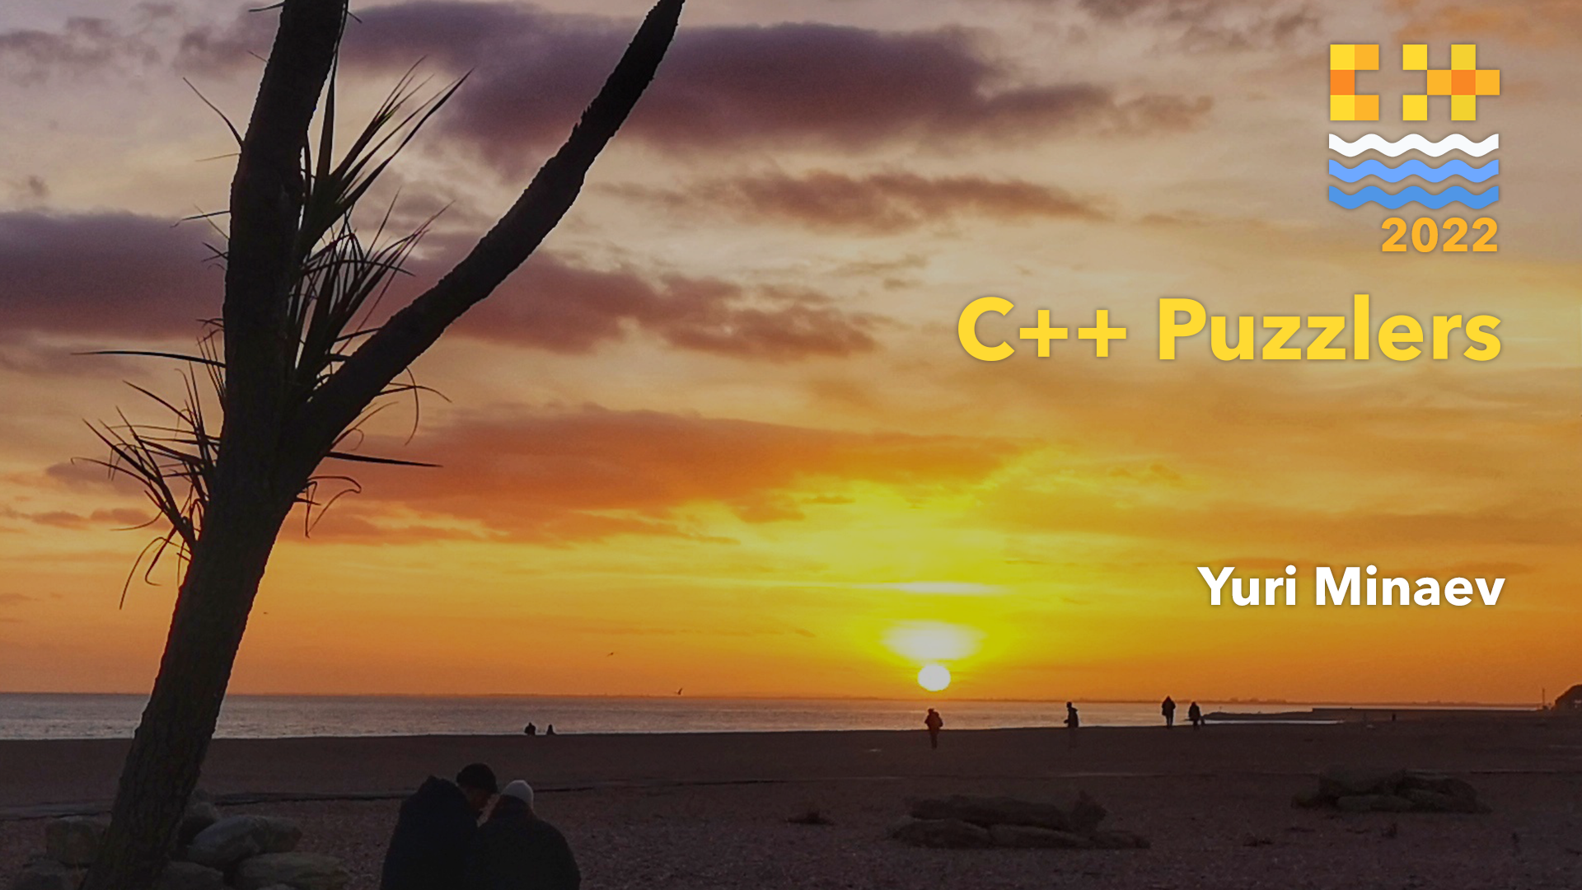

Slide 2

About me
PVS-Studio C++ analyser's architect.
I love C++, cats, and whining about legacy code
Notes:
Say what a static analyser is. Briefly

Slide 3
What is this talk about?
Exploring dusty corners of C++
Interactivity
Hopefully, learning something new
Having fun

Slide 4
C+++++

Slide 5
C+++++
int main()
{
int a = 5;
int b = 2;
std::cout << a+++++b;
}

Slide 6
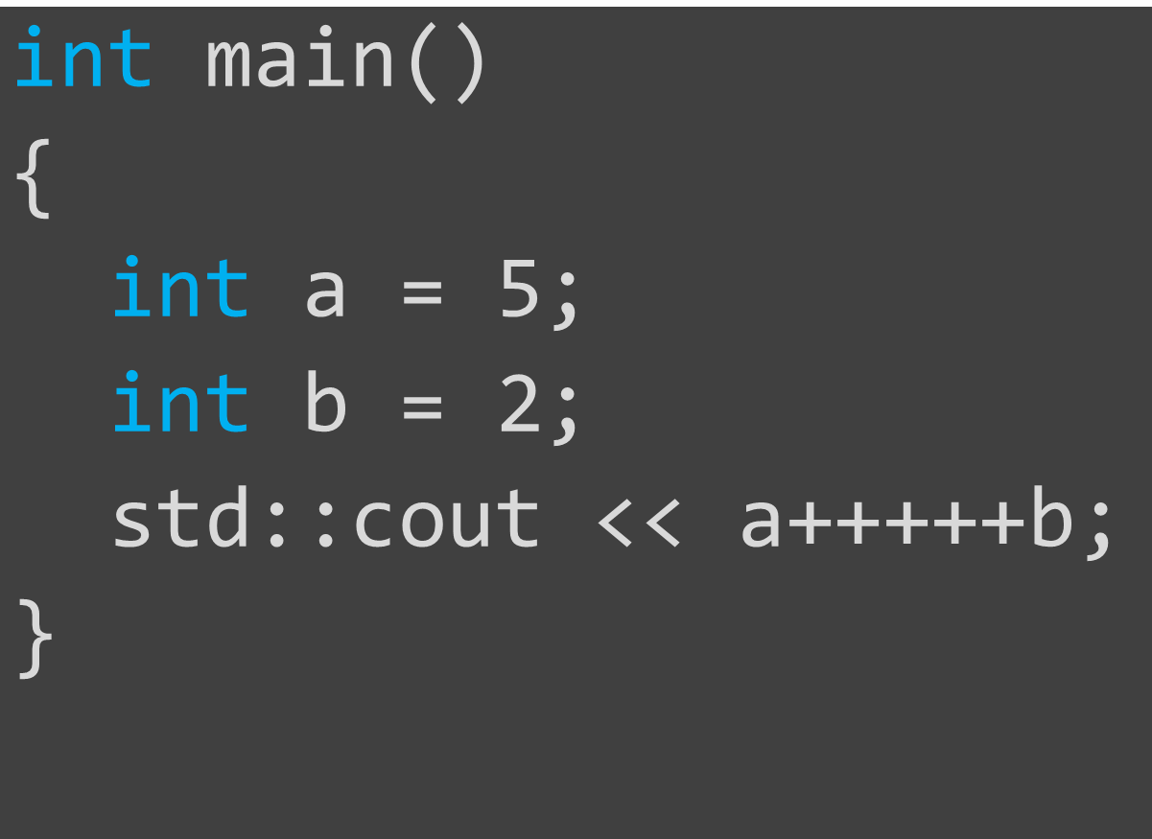
C+++++
Does it compile?
Why?

Slide 7


C+++++
a+++++b
a+++++b
a
:identifier

Slide 8
C+++++
a
:identifier
+++++b
++++b
+++++b
++++b
+
:addition
++
:increment

Slide 9

C+++++

Slide 10
C+++++
a+++++b
a
:identifier
++
:increment
++
:increment
+
:unary
b
:identifier

Slide 11
C+++++
a ++ ++ + b
lvalue
prvalue
oopsy
The operand expr of a built-in postfix increment or decrement operator must be a modifiable (non-const) lvalue of non-boolean (since C++17) arithmetic type or pointer to completely-defined object type. © cppreference.com

Slide 12
Templates everywhere

Slide 13
Templates everywhere
template <typename T>
T* gimme_addr(T &ref) { return &ref; }
struct thing;
template
const thing* gimme_addr(const thing &ref);
struct thing
{
const thing* operator&() const;
};

Slide 14
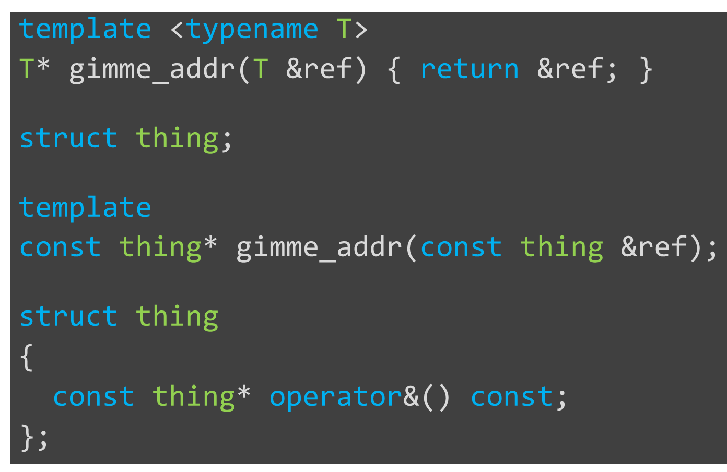
Templates everywhere
Does it compile?
What happens if it does?

Slide 15
Templates everywhere
Which operator?
Built-in &
thing::operator&

Slide 16
Templates everywhere
template <typename T>
T* gimme_addr(T &ref) { return &ref; }
struct thing;
template
const thing* gimme_addr(const thing &ref);
struct thing
{
const thing* operator&() const;
};

Slide 17
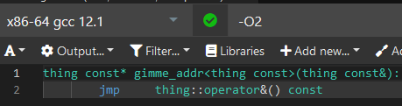

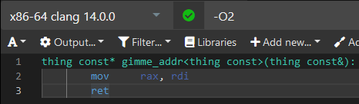

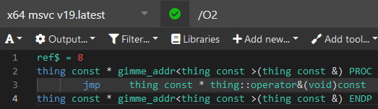

Templates everywhere
Which operator?

Slide 18
Templates everywhere
If & is applied to an lvalue of incomplete class type and the complete type declares operator&(), it is unspecified whether the operator has the built-in meaning or the operator function is called.
The operand of & shall not be a bit-field.
© C++ Standard 7.6.2.1.5

Slide 19
Know thy traits

Slide 20
Know thy traits
We need Data Flow analysis for C++
To store and track a value, you need a larger container size
I.e. 128 bits for your average 64-bit variable
int128 anyone?

Slide 21


Know thy traits

Slide 22
Know thy traits
class Int128 { /*Spooky things*/ };
template <>
struct std::is_signed<Int128>
: std::true_type {};
static_assert(std::is_signed_v<Int128>);

Slide 23
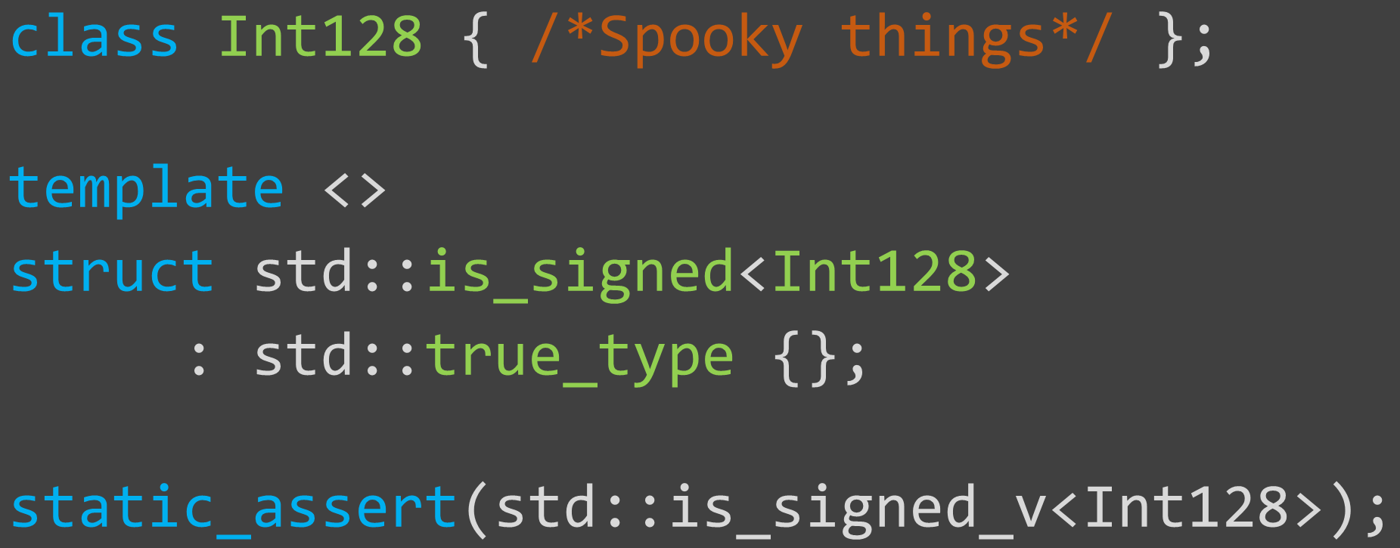
Know thy traits
Why are my tests failing like crazy all of a sudden?

Slide 24



Know thy traits

Slide 25



Know thy traits

Slide 26
Know thy traits
None of the templates defined in <type_traits> may be specialized for a program-defined type, except for std::common_type and std::basic_common_reference (since C++20). This includes the type traits and the class template std::integral_constant.
© cppreference.com

Slide 27
Schrödinger's variable

Slide 28
Schrödinger's variable
volatile int a;
int main()
{
std::cout << a + a;
}

Slide 29
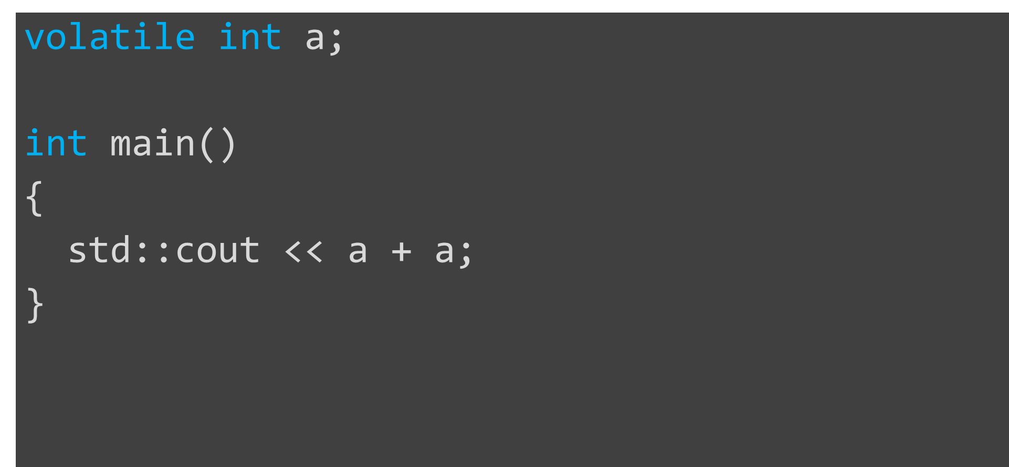
Schrödinger's variable
Does it compile?
Is this even legal?
What is going to happen?

Slide 30

Schrödinger's variable
Reading an object designated by a volatile glvalue, modifying an object, calling a library I/O function, or calling a function that does any of those operations are all side effects, which are changes in the state of the execution environment.
© C++ Standard 6.9.1.7

Slide 31
Schrödinger's variable
Except where noted, evaluations of operands of individual operators and of subexpressions of individual expressions are unsequenced.[...]
If a side effect on a memory location is unsequenced relative to either another side effect on the same memory location or a value computation using the value of any object in the same memory location, and they are not potentially concurrent, the behavior is undefined.
© C++ Standard 6.9.1.10

Slide 32
Schrödinger's variable
==
UB*
* In case a is a volatile entity**
** The big 3 don't seem to care

Slide 33

Schrödinger's variable
a
a

Slide 34
The future is now

Slide 35
The future is now
auto thing = "fluffy"sv;
std::async(std::launch::async,
[&thing] { thing = "spooky"sv; });
std::async(std::launch::async,
[&thing] { thing = "jabberwock"sv; });
std::cout << thing << std::endl;

Slide 36
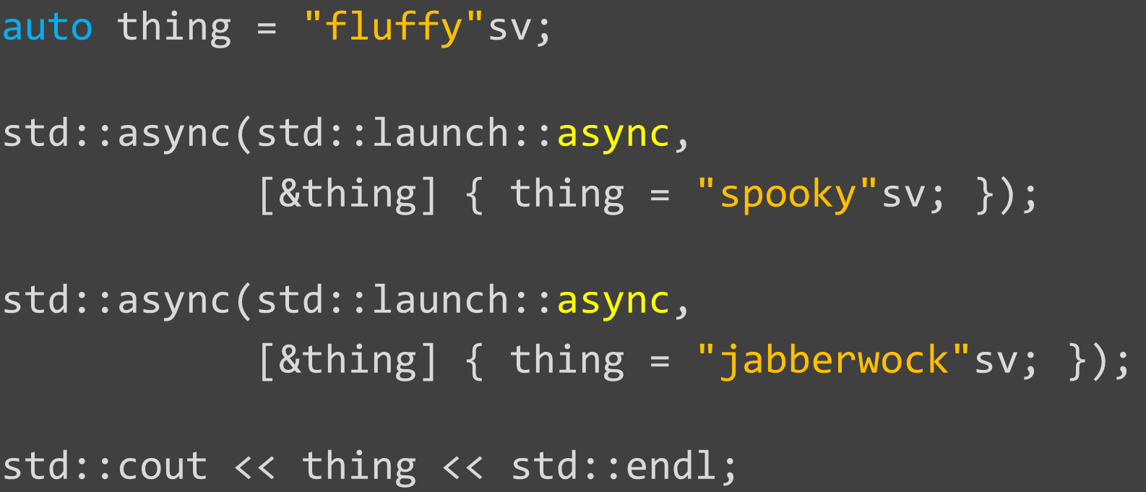
The future is now
What will it cout?
Is there, by chance, a data race here?

Slide 37
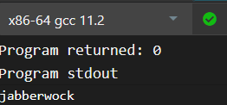
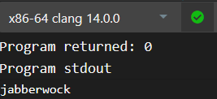
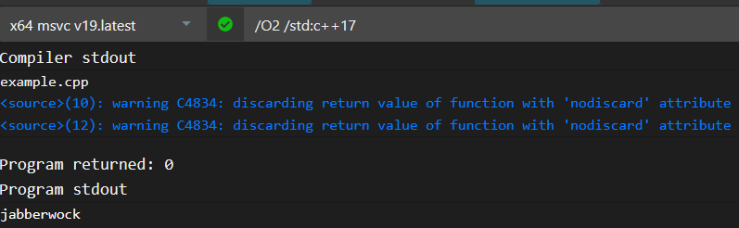
The future is now
Output?

Slide 38
The future is now
std::async(...);
std::future<...>
future::~future()

Slide 39
The future is now
If the implementation chooses the launch​::​async policy
[...]
the associated thread completion synchronizes with the return from the first function that successfully detects the ready status of the shared state or with the return from the last function that releases the shared state, whichever happens first.
© C++ Standard 32.9.9.6.4

Slide 40
The future is now
auto thing = "fluffy"sv;
std::async(std::launch::deferred,
[&thing] { thing = "spooky"sv; });
std::async(std::launch::deferred,
[&thing] { thing = "jabberwock"sv; });
std::cout << thing << std::endl;

Slide 41
The future is now
auto thing = "fluffy"sv;
std::async(std::launch::deferred,
[&thing]
{
thing = "spooky"sv;
})
.wait_for(5s);
std::cout << thing << std::endl;

Slide 42
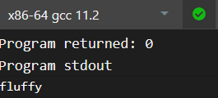
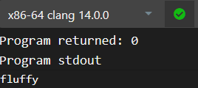
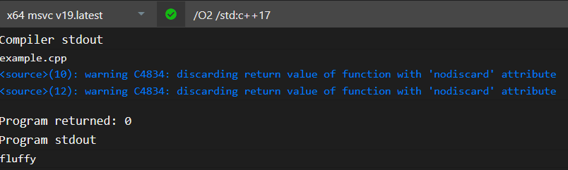
The future is now
Output?

Slide 43
The future is now
If launch​::​deferred is set in policy[...]
The shared state is not made ready until the function has completed.
The first call to a non-timed waiting function on an asynchronous return object referring to this shared state invokes the deferred function in the thread that called the waiting function.
© C++ Standard 32.9.9.4.2

Slide 44


